Slide 1
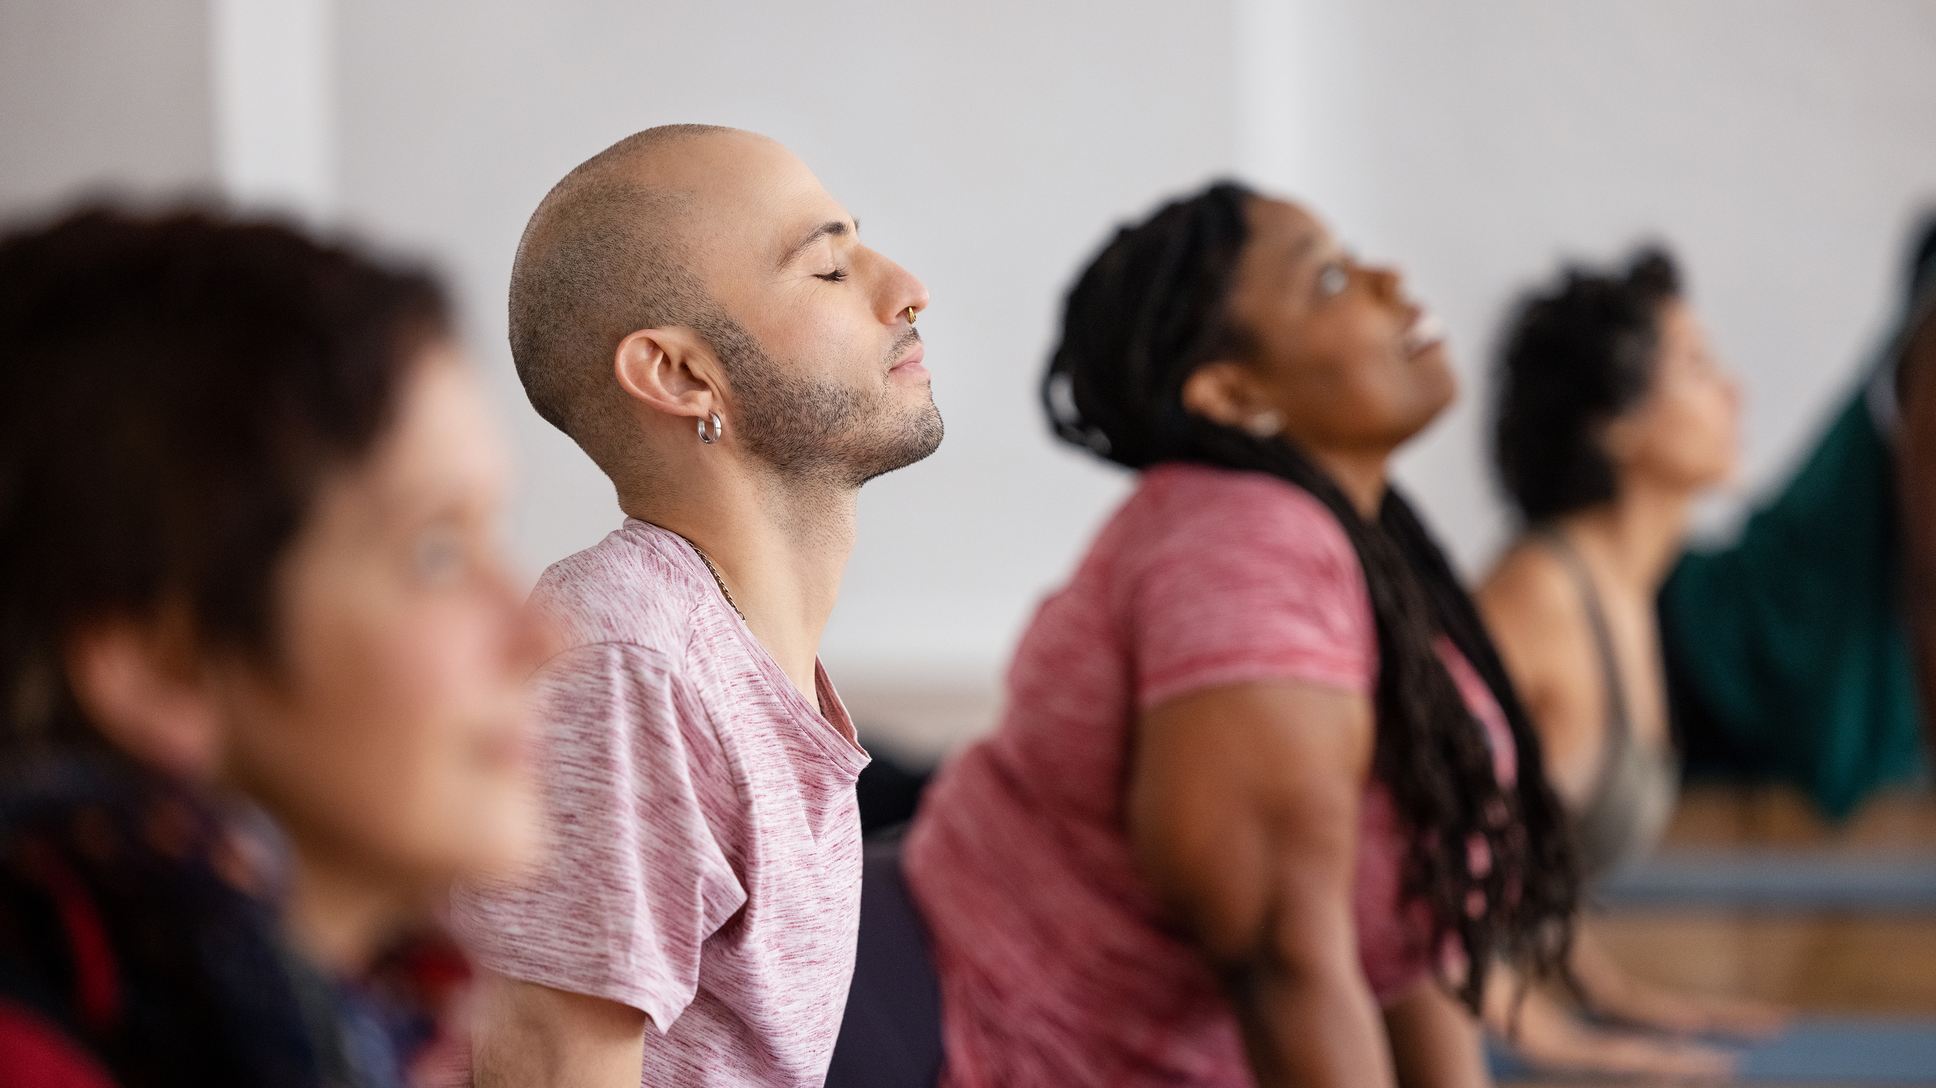
OpenPosture
Phase 2
By: Michael Nweke, Ally Ryan, Parisha Rathod

Slide 2
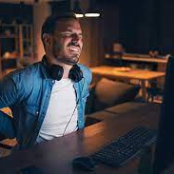
Background
As developers who spend hours at our screens, we often deal with neck and back pain. Recognizing this shared struggle, we decided to tackle it together. Drawing from our collective experiences and a growing need for ergonomic solutions, we set out to create a practical tool. Thus, the idea for a sitting posture detection system was born. Using Python's OpenCV library and a Keras/TensorFlow model, we aim to provide real-time feedback to help developers like us mitigate discomfort and promote better overall health.

Slide 3
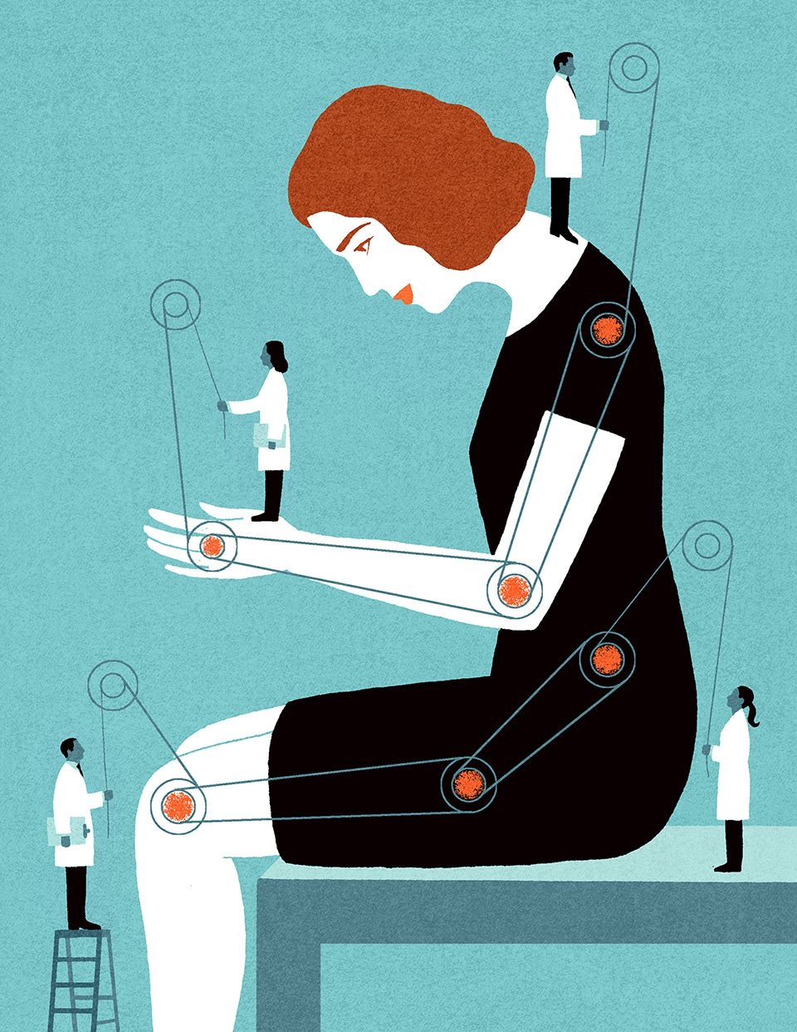
Intro
OpenPosture: Aimed at improving seated
posture using computer vision.
Mitigate back, neck, and hip pain caused by
poor posture and prolonged sitting.
Utilizes OpenCV for key point detection,
with dependencies on Keras and
TensorFlow.
Uses MIT's "Seated-Posture-Recognition"
Initiative as a starting point.

Slide 4
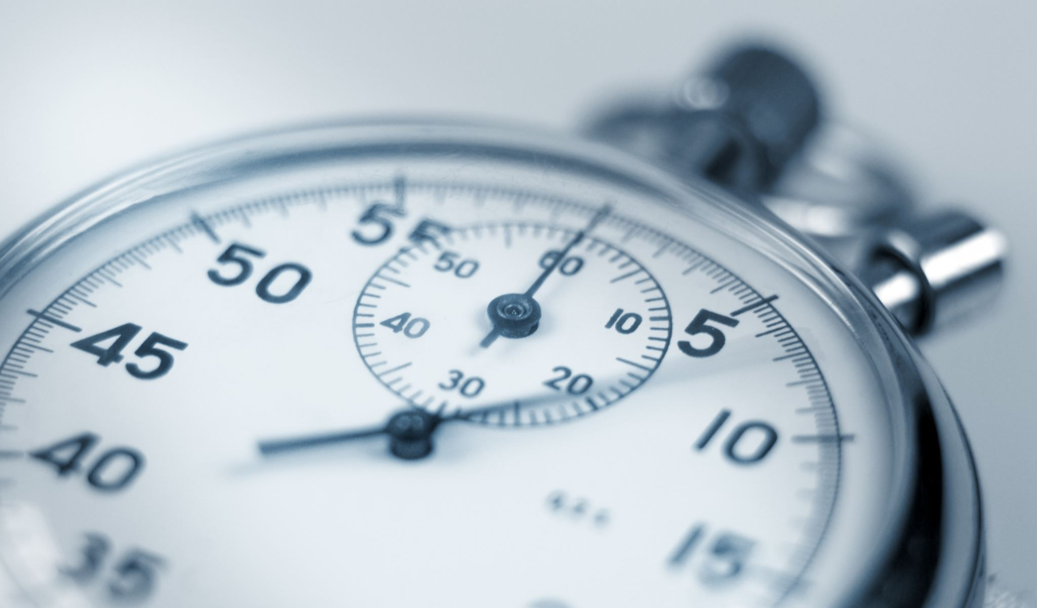
Preliminary Analysis
Source Code is not maintained. Project was created in 2018.

Slide 5




Triangle Model

Slide 6
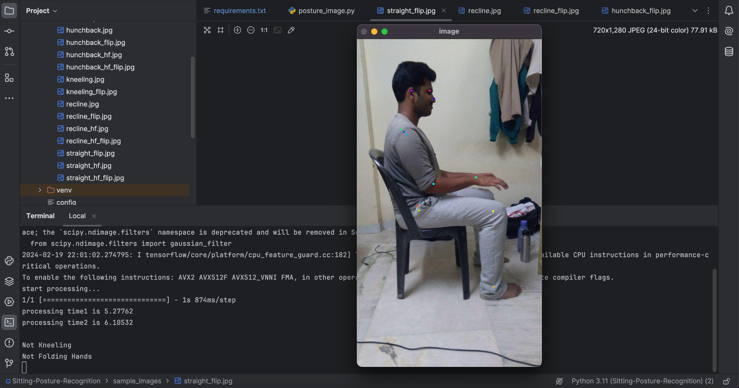
Source Code Results

Slide 7
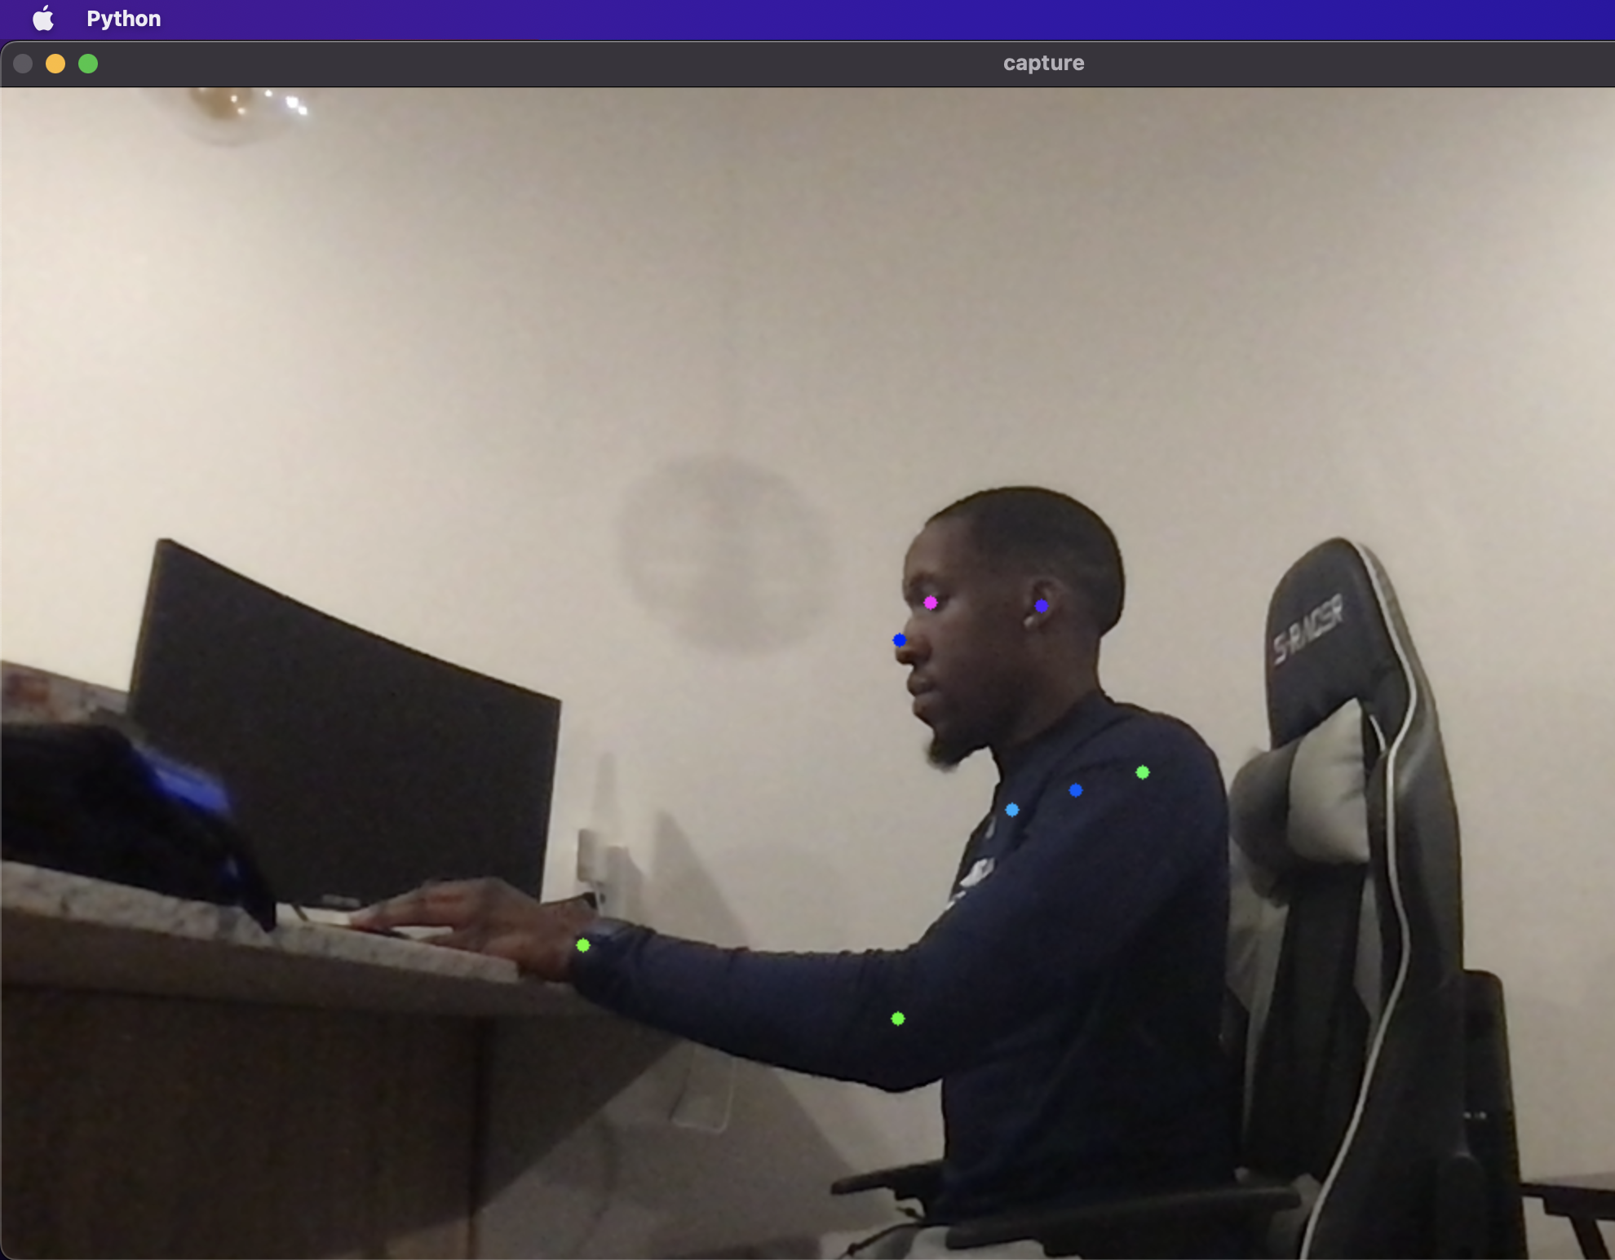
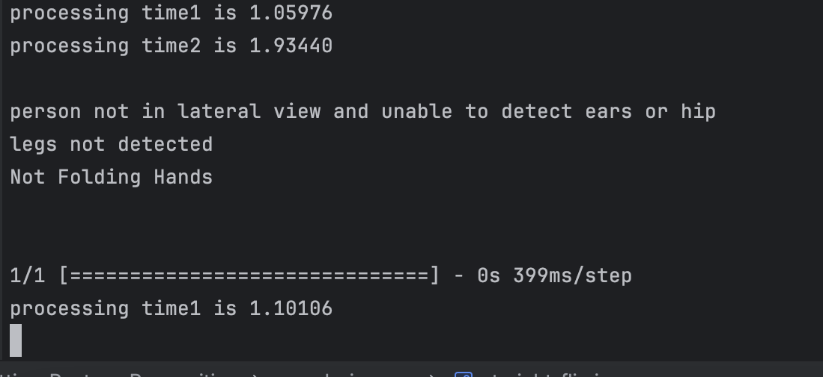
Real Time

Slide 8


Slide 9
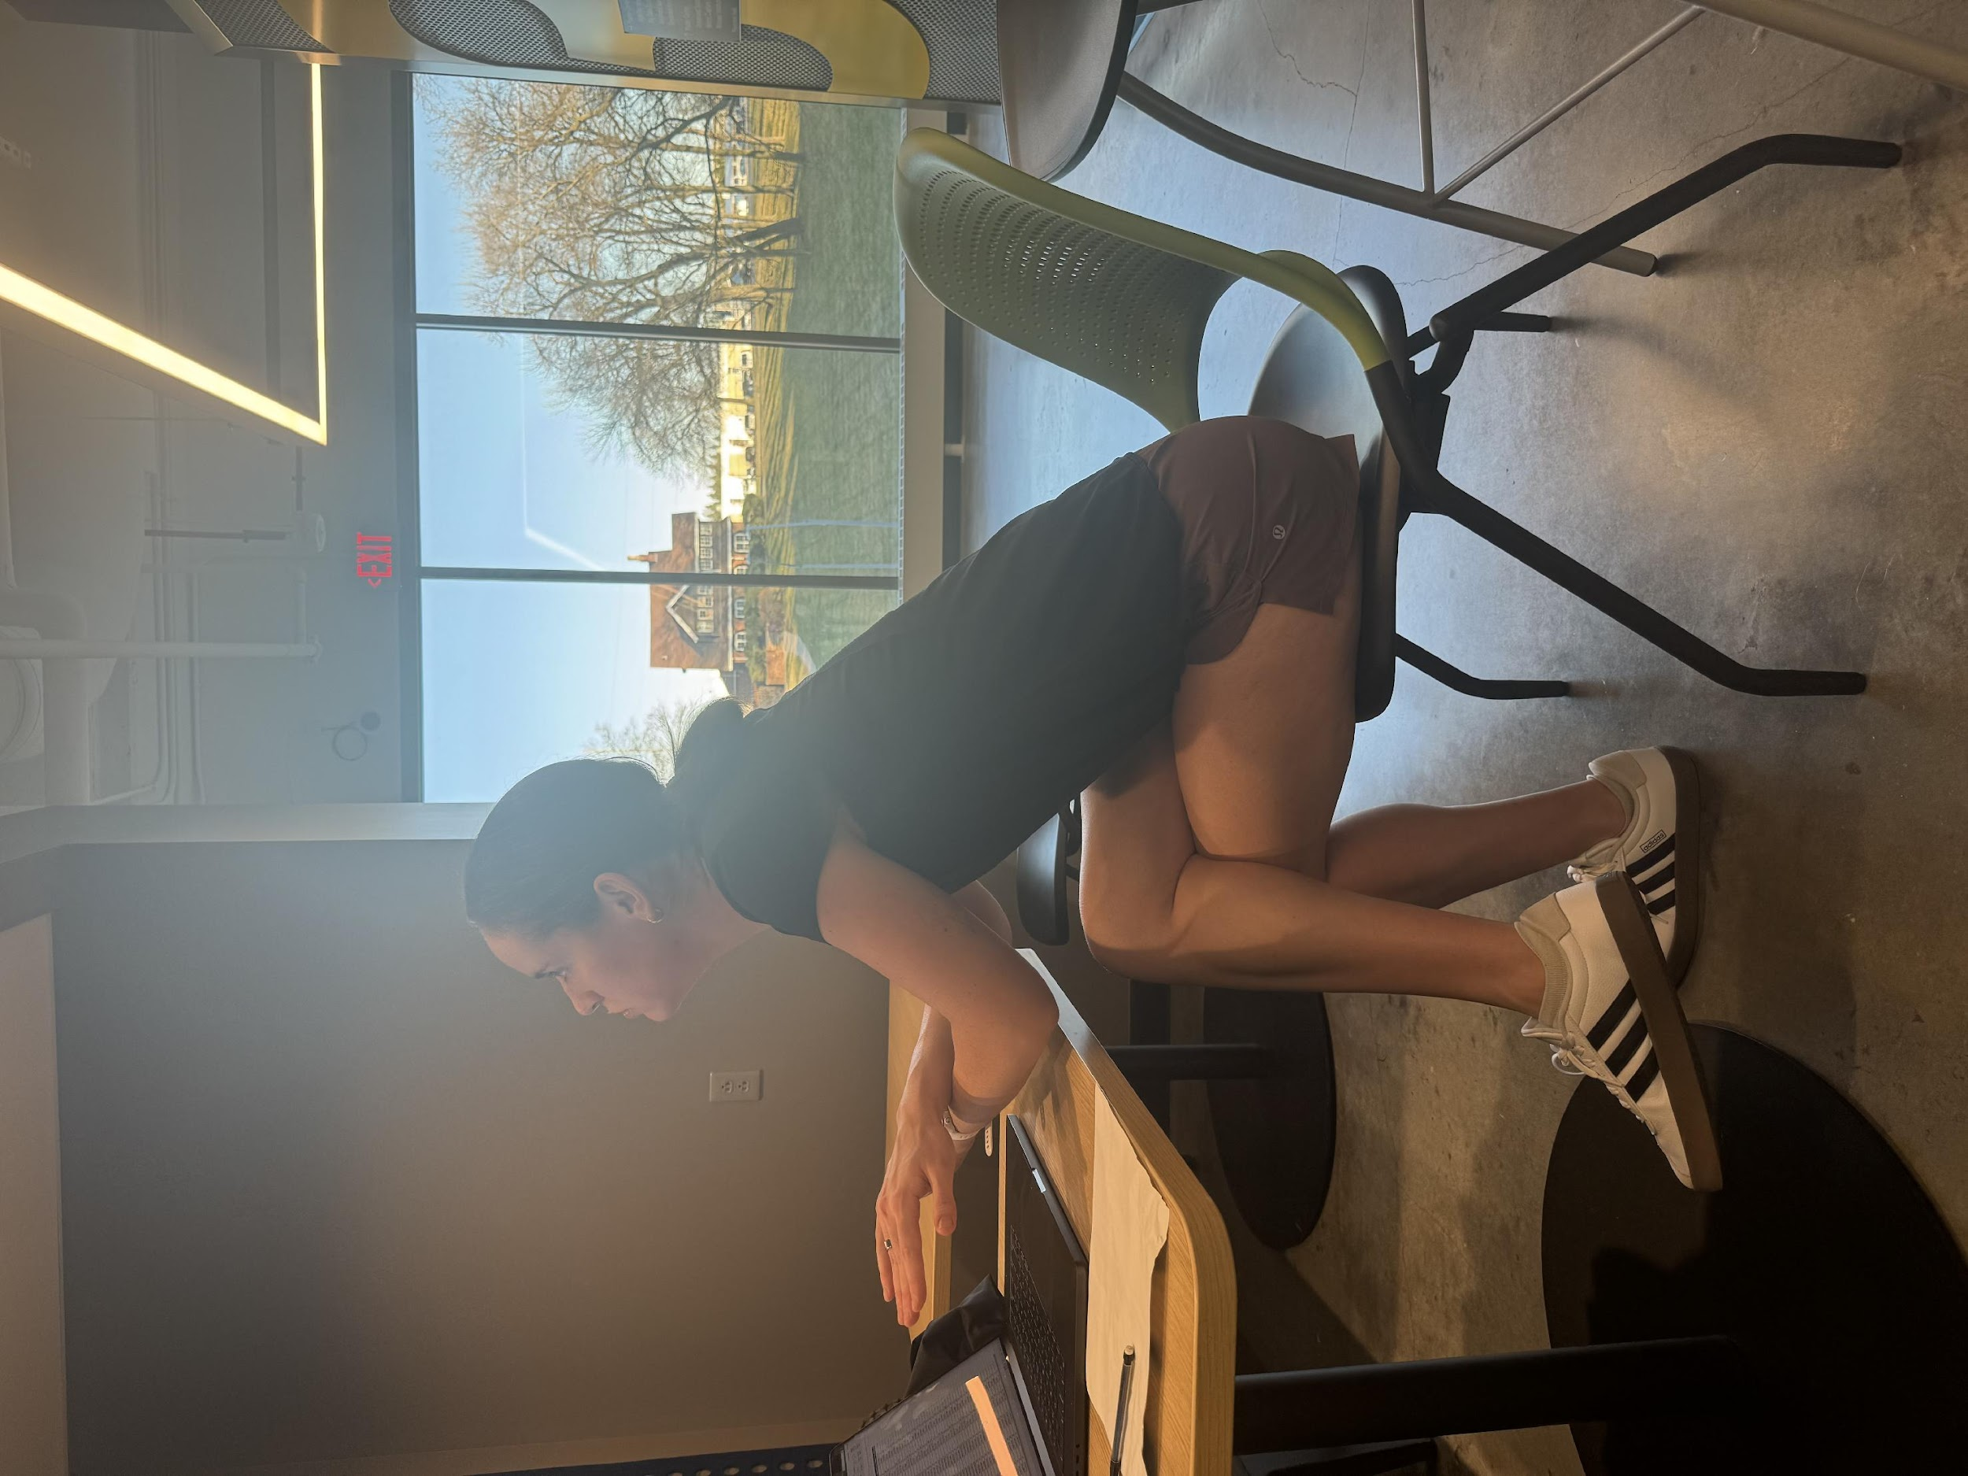
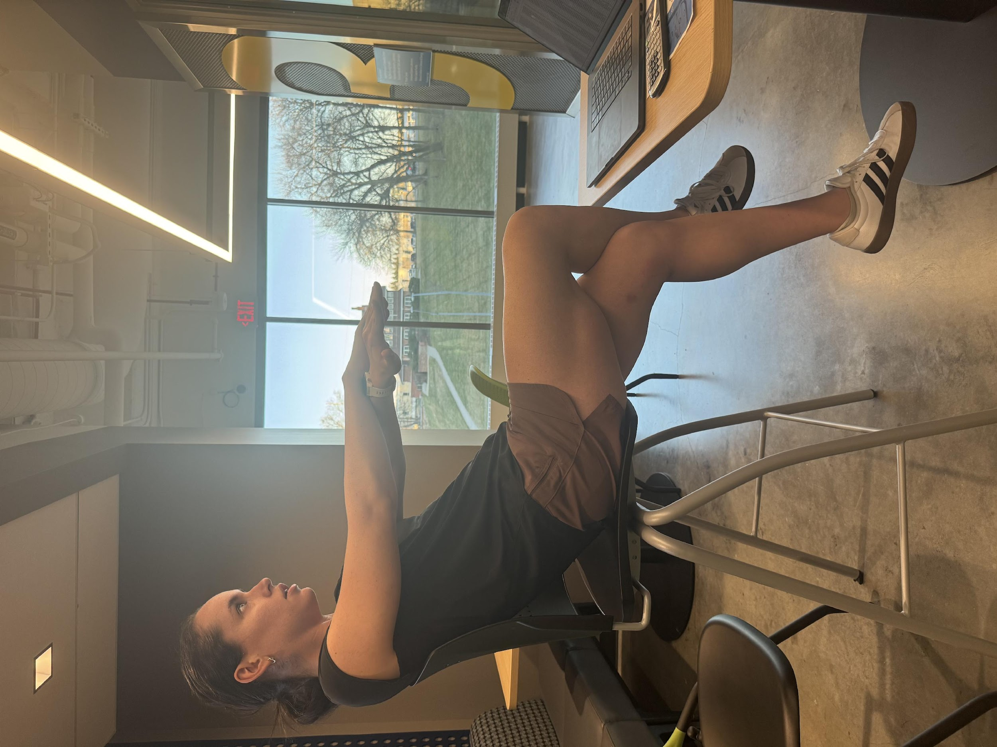


Left Side
Right Side

Slide 10
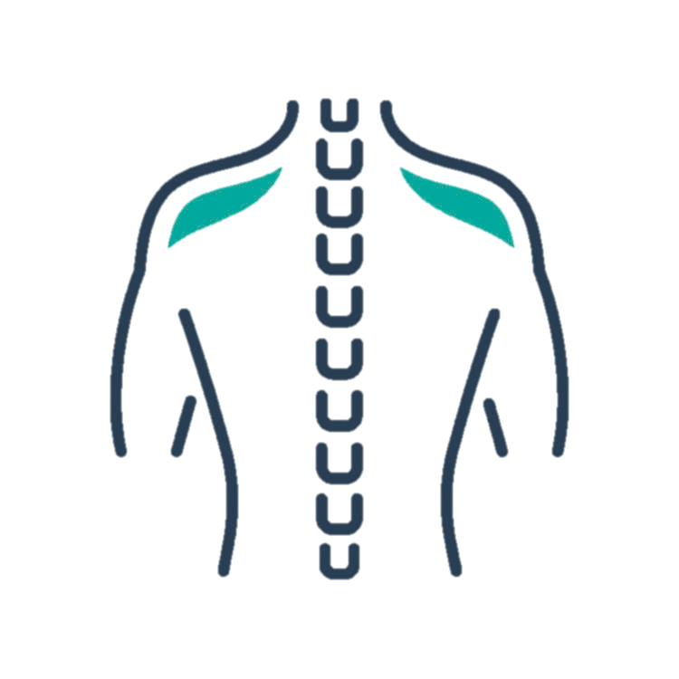
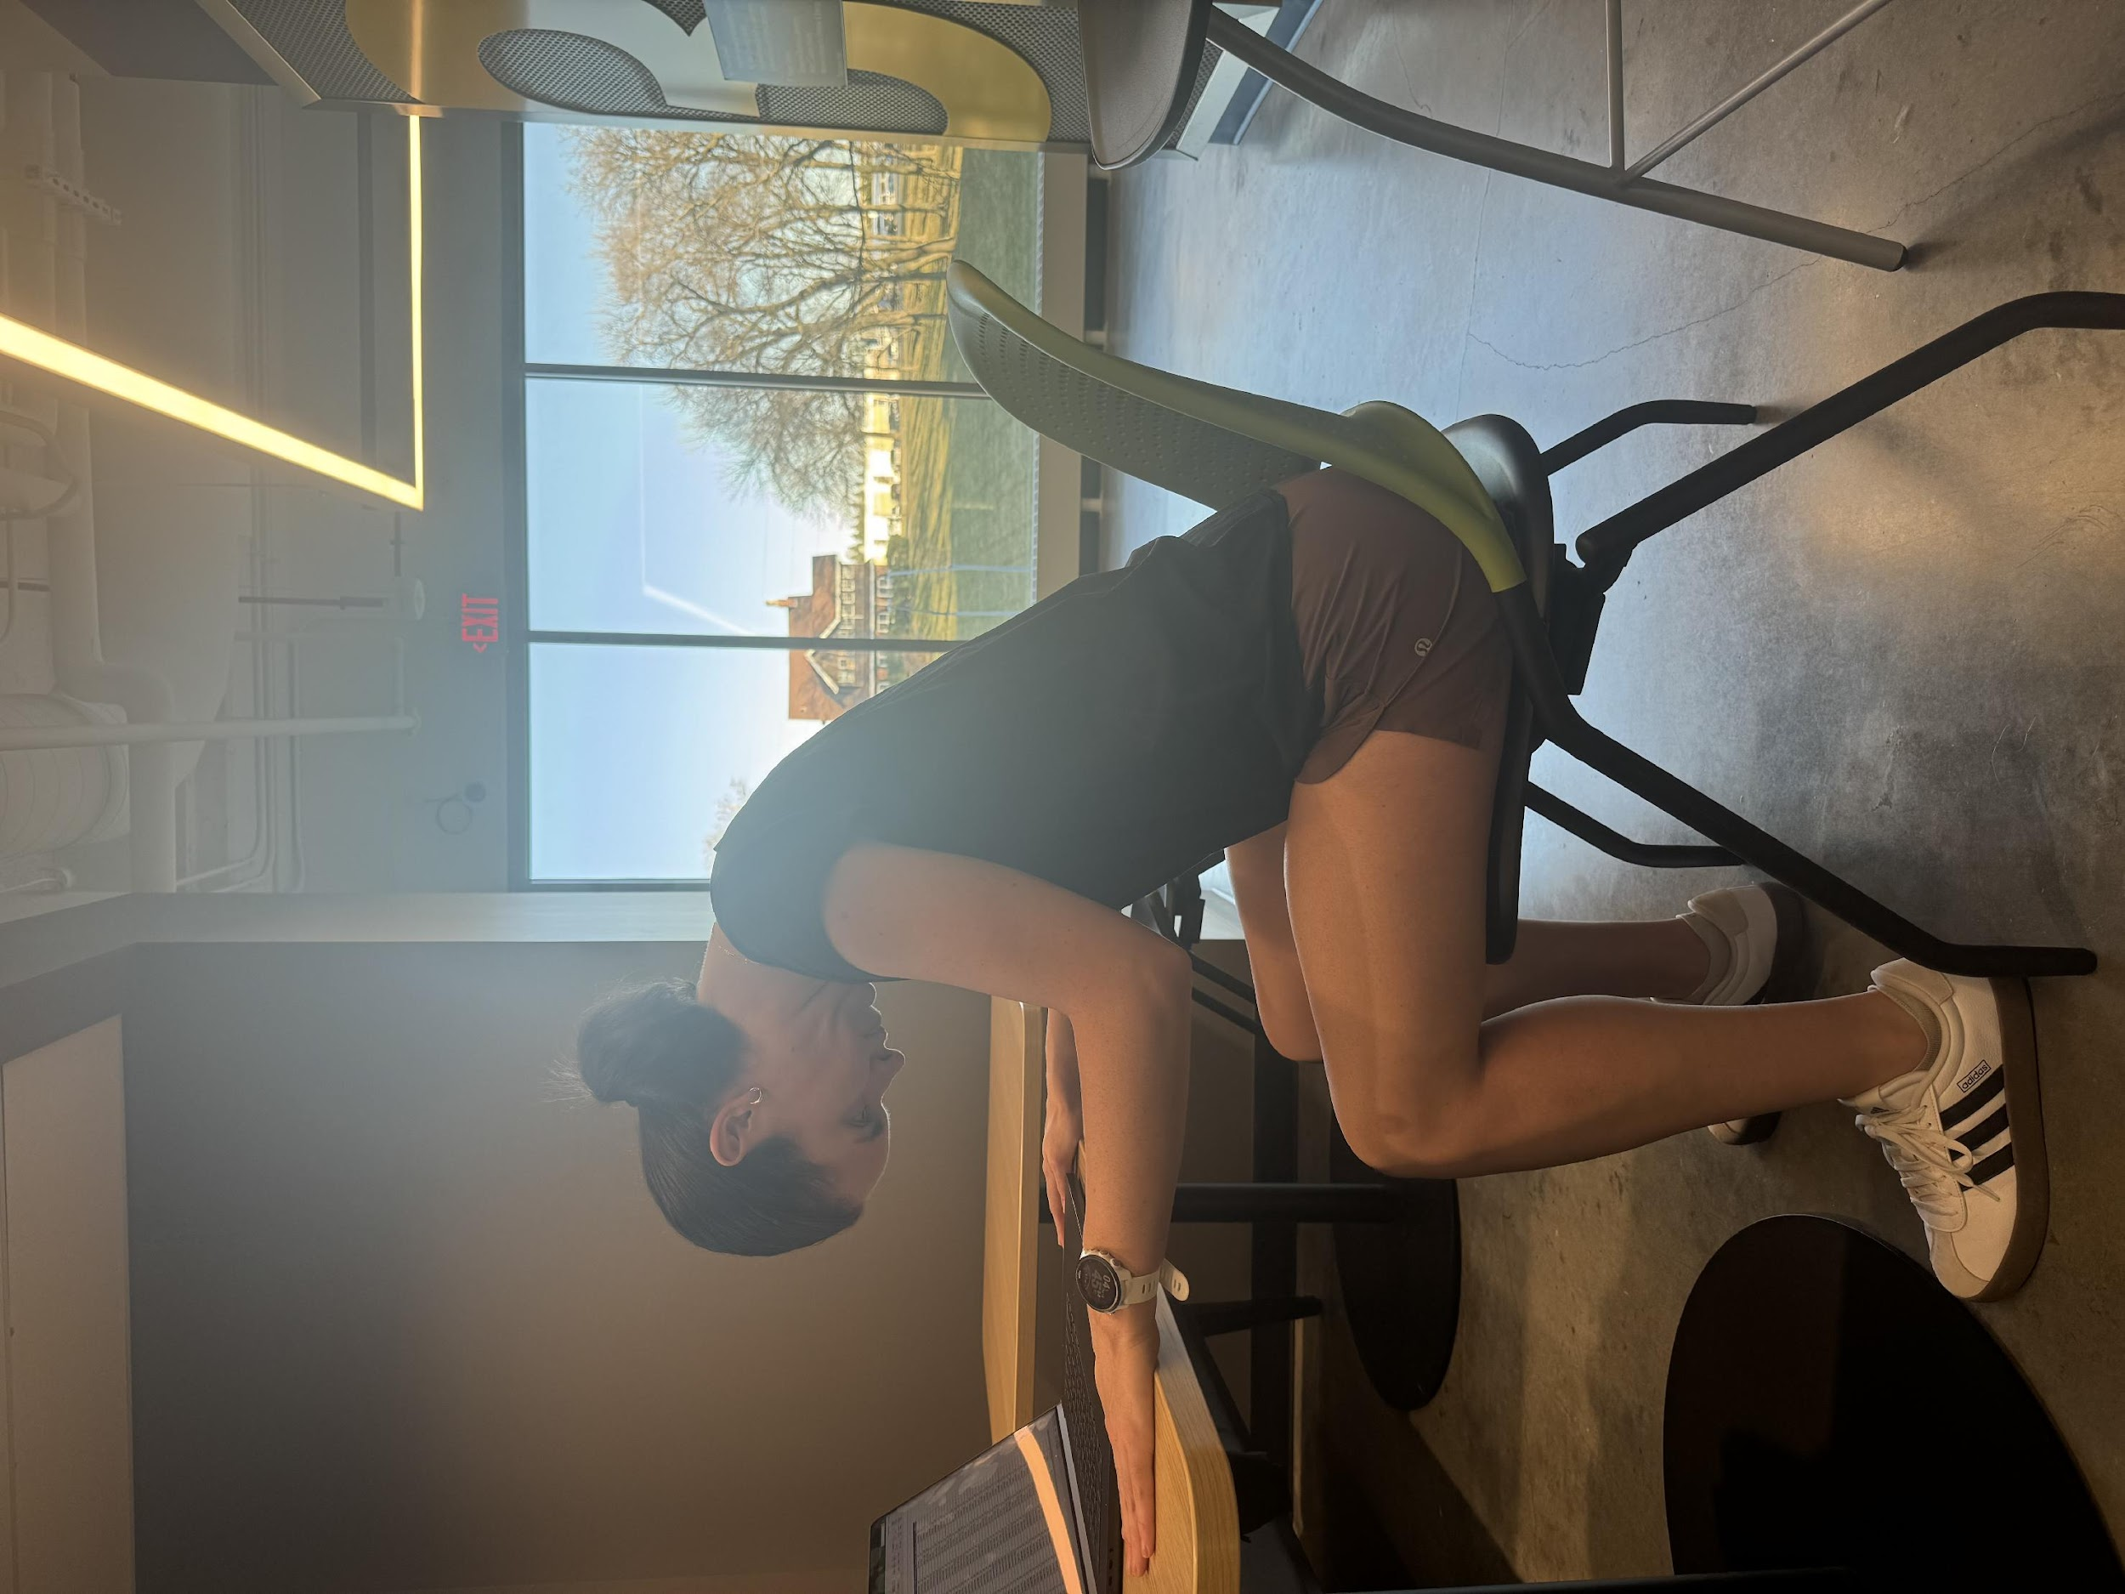
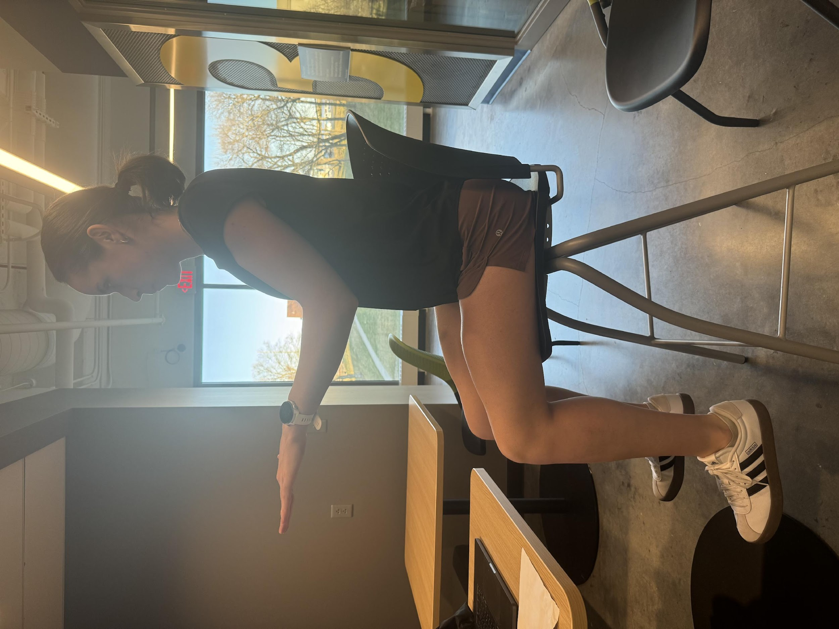
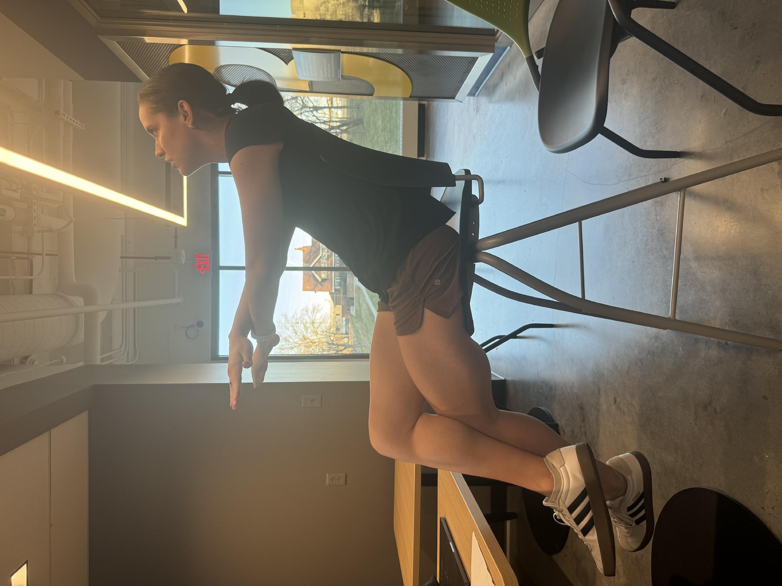
Leaning Forward
Straight
Leaning Backward

Slide 11

Downwards
Straight
Upwards

Slide 12

Folded
Unfolded

Slide 13
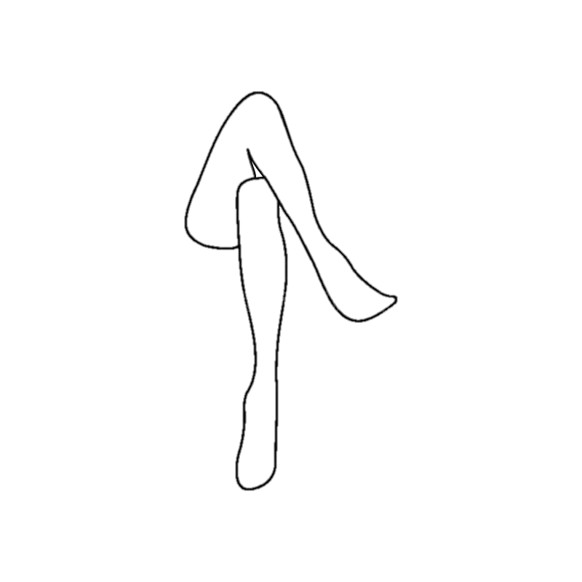
Crossed
Uncrossed

Slide 14
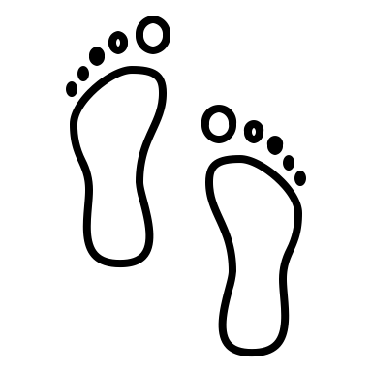
Not On Floor
On Floor

Slide 15
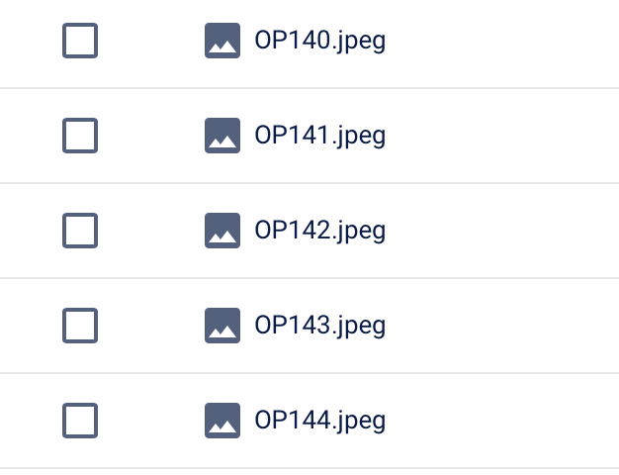


Slide 16
Methodologies: Currently Working On
Developing code for functions that detect:
Neck: Eye location and neck angle
Feet: Ankle vs floor position
Legs: Angle of knees
Integrating real-time detection to frontend

Slide 17
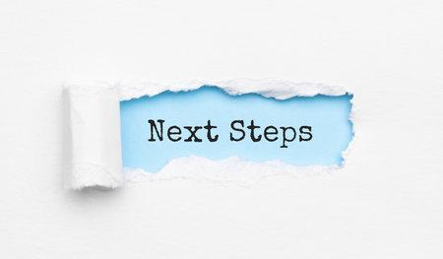

Slide 18
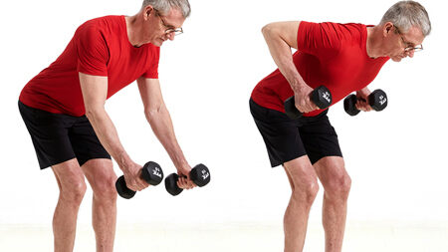
Resolve Back Pain Caused By Leaning Forward
Bent Over Row: 4 Sets 8-10 Reps

Slide 19
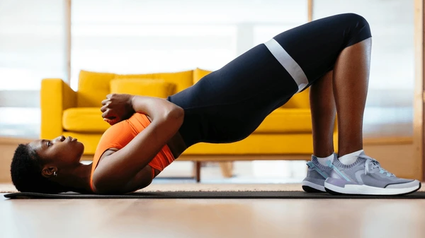
Resolve Hip Pain Caused By Frequent Leg Crossing
Bridge: 3 x 30 seconds

Slide 20

Additional Plans - Use Object Detection in feedback
Ex. Computer, desk, and keyboard are at an appropriate level for optimal posture. No recommendations.

